Slide 1
Barboza, Flavio, Herbert Kimura, and Edward Altman. "Machine learning models and bankruptcy prediction." Expert Systems with Applications 83 (2017)
Abstract
Predicting bankruptcy and default events, for credit risk management.
We test machine learning models (support vector machines, bagging, boosting, and random forest) to predict bankruptcy one year prior to the event, and compare their performance with results from discriminant analysis, logistic regression, and neural networks.
DATA: From 1985 to 2013 on North American firms, integrating information from the Salomon Center database and Compustat, analysing more than 10,000 firm-year observations.
→ Machine learning models show, on average, approximately 10% more accuracy in relation to traditional models.

Slide 2
1. Introduction
1) Logistic regression analysis to default estimation(Ohlson, 1980)
Determines the default probability of the potential borrower
Inaccurate and suggested the need for enhancements in the modelling of default risk
2) Artificial intelligence and machine learning tools
Credit risk analysis is similar to pattern-recognition problems, algorithms can be used to classify the creditworthiness of counterparties (Kruppa, Schwarz, Arminger, & Ziegler, 2013; Pal, Kupka, Aneja, & Militky, 2016)
Improving upon traditional models based on simpler multivariate statistical techniques such as discriminant analysis and logistic regression.
3) Support vector machines (SVMs)(Cortes & Vapnik, 1995)
Generate functions similar to discriminant analysis, but they are not subject to series of assumptions and so are less restrictive.
4) Boosting, bagging, and random forest models
Machine learning techniques, such as ensemble methods, lead to better classification than standalone methods
Wang, Hao, Ma, and Jiang (2011) used ensemble methods (bagging, boosting, and stacking) coupled with base learners (logistic regression, decision trees, ANN, and SVM) to find that bagging outperformed boosting for all credit databases they analyzed.

Slide 3
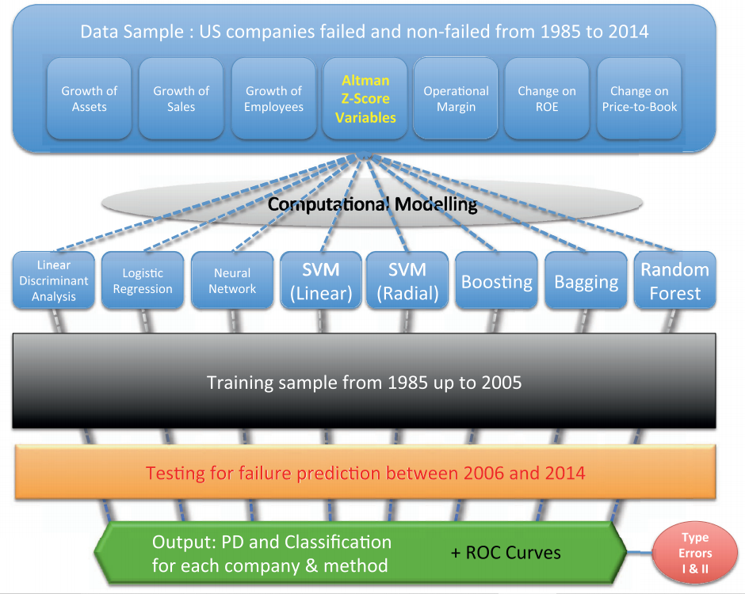
The proposed methodology

Slide 4
2. Theoretical background
In this study, machine learning mechanisms are designed to distinguish between bankrupt and non-bankrupt companies based on firm characteristics such as profitability, liquidity, leverage, size, and growth measures. We compare applications of SVM, boosting, bagging, and random forest methods with artificial neural networks, logistic regression, and discriminant analysis.

Slide 5
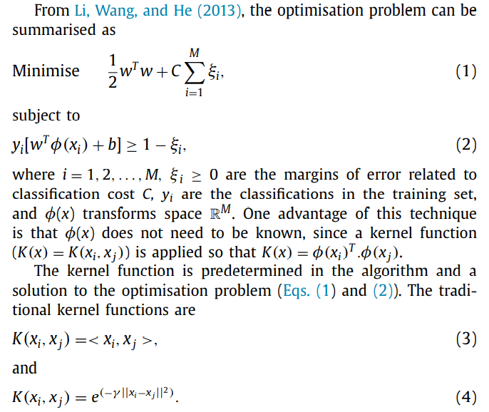
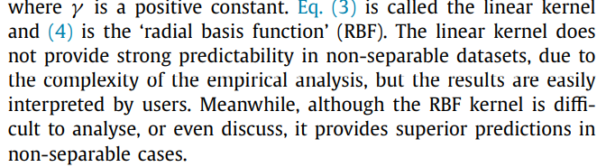
2.1. Support Vector Machine
Li, Shouwei, Mingliang Wang, and Jianmin He. "Prediction of banking systemic risk based on support vector machine." Mathematical Problems in Engineering 2013 (2013).

Slide 6
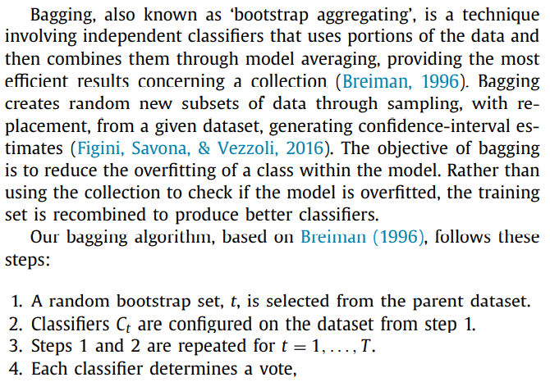
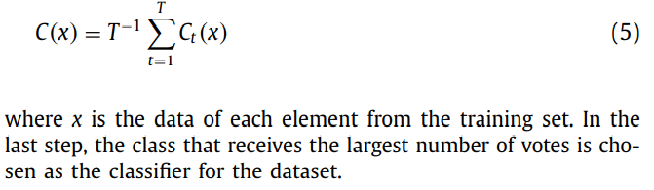
2.2. Bagging

Slide 7
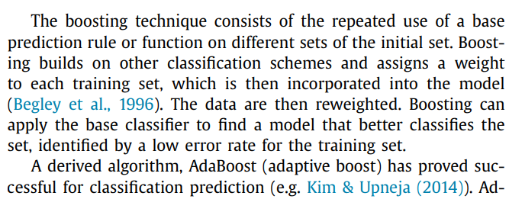
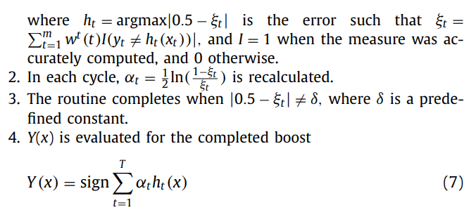
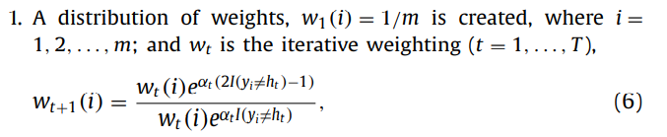
2.3. Boosting
In this paper, boosting algorithm follows
Heo, Junyoung, and Jin Yong Yang. "AdaBoost based bankruptcy forecasting of Korean construction companies." Applied soft computing 24 (2014): 494-499.

Slide 8
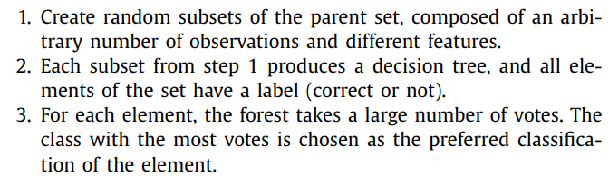
2.4. Random Forest
In this paper, RF algorithm follows Yeh’s paper
- Yeh, Ching-Chiang, Der-Jang Chi, and Yi-Rong Lin. "Going-concern prediction using hybrid random forests and rough set approach." Information Sciences 254 (2014): 98-110.

Slide 9
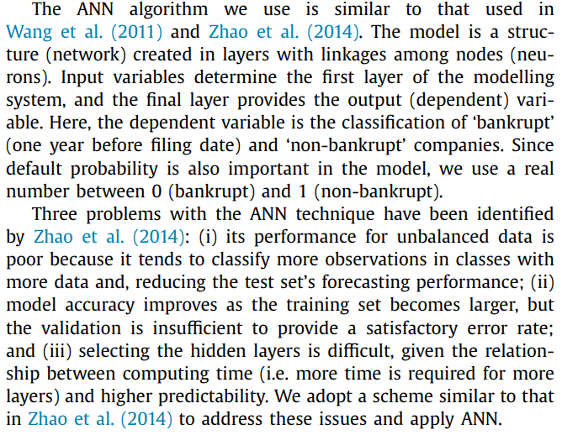
2.5. ANN
In this paper, the used ANN algorithm is similar to Wang(2011) and Zhao(2014) models
Wang, Gang, et al. "A comparative assessment of ensemble learning for credit scoring." Expert systems with applications 38.1 (2011): 223-230.
Zhao, Zongyuan, et al. "Investigation and improvement of multi-layer perceptron neural networks for credit scoring." Expert Systems with Applications 42.7 (2015): 3508-3516.

Slide 10
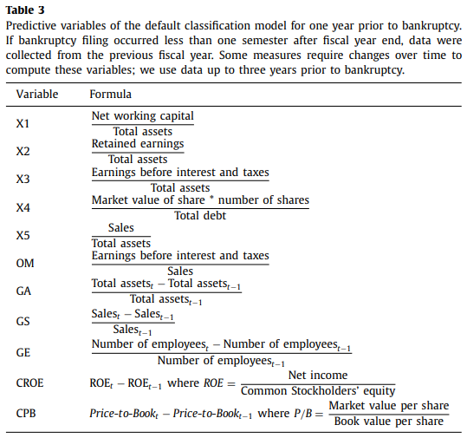
3. Data and method
Financial data on American and Canadian companies covering 1985 to 2013 using Compustat.
Information on firm insolvency was collected from NYU’s Salomon Center database.
A subset covering 1985 to 2005 was extracted to provide the training set, which included information on 449 companies that filed for bankruptcy during this period as well as information on the same number of non-bankruptcy firms.
Predictive variables
liquidity (X1), profitability (X2), productivity (X3), leverage (X4), and asset turnover (X5).
Growth of assets (GA), growth in sales (GS), growth in the number of employees (GE), operational margin (OM), change in return on equity (CROE), and change in price-to-book ratio (CPB) (Carton & Hofer, 2006).

Slide 11
3. Data and method
The validation set contains a randomly chosen group of 133 bankrupt firms and 13,300 companies considered solvent from 2006 (which it is not included in the training set) and 2013.
Eight techniques were applied:
Bagging,
Boosting, Random forest (RF), SVM with two kernels: linear (SVM-Lin) and radial basis function (SVM-RBF), Artificial neural networks (ANN), Logistic regression (Logit), and MDA.
We implemented the models using the R statistical software packages. Specifically, this study used ada, e1071, mboost, random Forest, MASS, aod, and nnet to implement bagging, SVM, boosting, random forest, MDA, Logit, and ANN, respectively.
For the machine learning models, the regression trees were used as base learners for bagging and random forest, while recursive partitioning trees were applied by SVM. It is important to note that these learners are presented in the default package settings

Slide 12
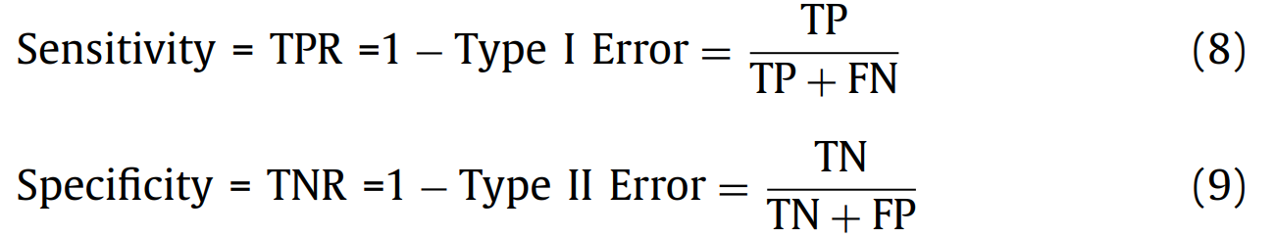
3. Data and method
The ROC curve was calculated for all models for the training and validation sets by using the ROCR package, providing a critical analysis of the evolution of machine learning.
The AUC also provided a criterion of accuracy for the validation set: the AUC had to be more than 0.5 for the model to be acceptable, and the closer it was to 1, the stronger its predictive power.
Two commonly applied performance rates (Kim & Upneja, 2014; Wang, Ma, Huang, & Xu, 2012) were calculated
→ The true positive rate (TPR) or sensitivity and the true negative rate (TNR) or specificity, which are equivalent to 1−type I error and 1−type II error, respectively.
where TP is True Positive, that is, bankrupt firms classified correctly and TN is True Negative, that is, non-bankrupt firms classified correctly. Sensitivity has values close to 1 when type 1 error is low, and specificity is close to 1 when type II error is low.

Slide 13
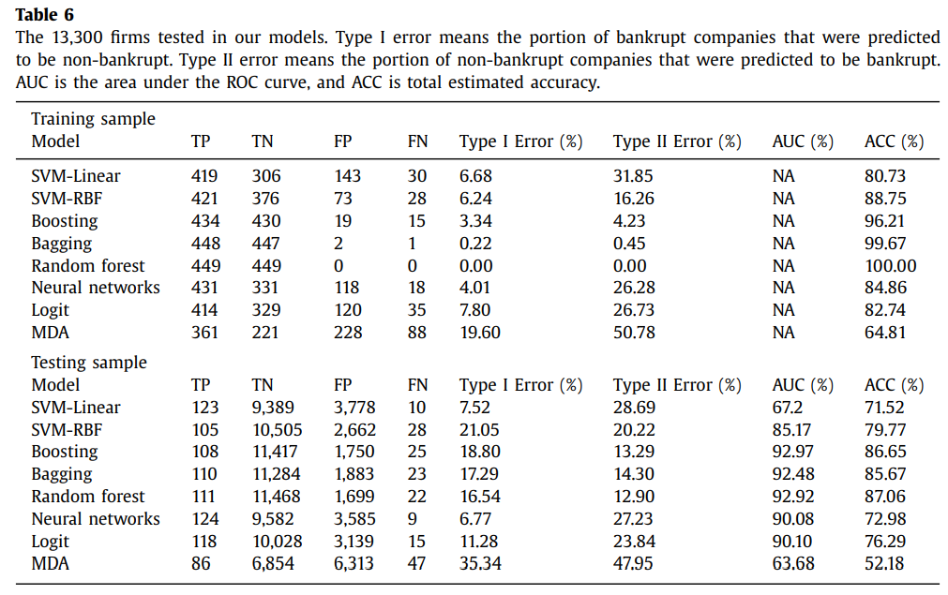
4. Results
Table 6 shows the metrics (AUC, ACC, Type I and Type II errors) discussed above when the models were applied to the test set. Machine learning models outperform traditional models measured on the validation set, except SVM-Lin. The linear structure applied to separate the two classes (bankrupt vs. non-bankrupt) causes this weak performance, since MDA, which uses a linear process, displays a similar accuracy problem.

Slide 14
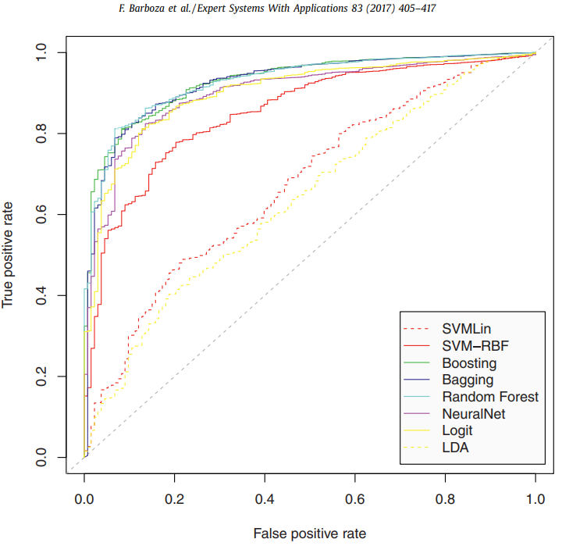
4. Results
Bagging shows reasonable performance and may provide an interesting alternative to the more computationally intense machine learning systems. Type II error was the second-best rate among the eight models tested (1.4% above RF) and third-best for AUC and ACC. Fig. 2 shows the ROC curve of each model.
Bagging, boosting, and RF are the most promising candidates

Slide 15
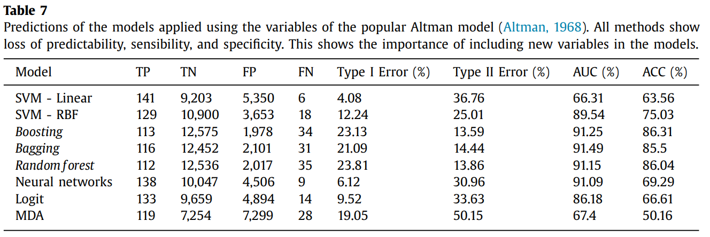
4. Results
Table 7 shows the results using only the variables from Altman (1968).
In all tests without exception, the three machine learning techniques – boosting, bagging and RF – showed better outcomes in all tests, with the latter usually being the best.

Slide 16
5. Conclusion
Strength of the study
First, we argue that significant predictive accuracy was achieved by using machine learning models under restrictive conditions such as existence of high correlated variables, outliers, and missing values
We also highlight that our using of an extensive database of defaults is not common in papers related to corporate bankruptcy. Many studies that investigate default are restricted to a specific credit product of a specific financial institution
Accuracy rates close to 90% in the testing sample represents evidence of the suitability of machine learning models to analyse corporate default.
Weakness of the study
As we used default parameters of the algorithms implemented in R packages, we do not take advantage of the full capacity of the models. Nonetheless, even by using simple settings of the algorithms, results show a relevant superiority of machine learning techniques.
In addition, our study did not focus on feature selection, which is a common procedure in recent studies that explore a high number of variables.

